Slide 1
Support Vector Machine (SVM) classifier
Volha Shyrayeva, FAMCS,
08.10.2019

Slide 2
Contents
How SVM works : theory and visual explanation.
Introduction to Non-Linear SVM tricks.
Tuning parameters of SVM.

Slide 3
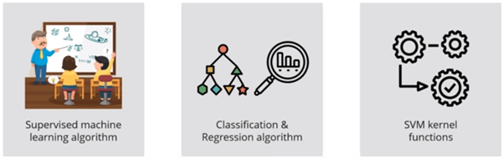
How SVM works : theory
SVM is a supervised classification method that separates data using hyperplanes.
https://medium.com

Slide 4
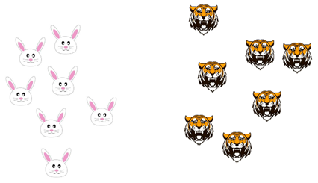
https://medium.com

Slide 5
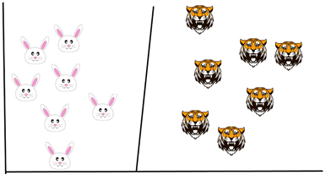
https://medium.com

Slide 6
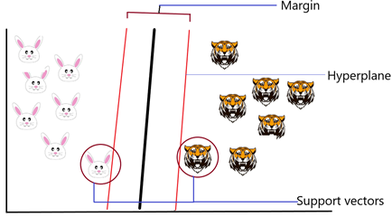
https://medium.com

Slide 7
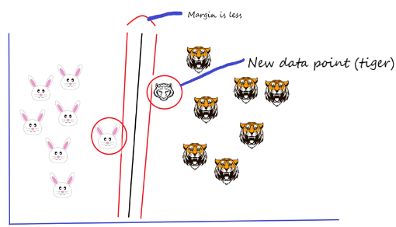
https://medium.com

Slide 8
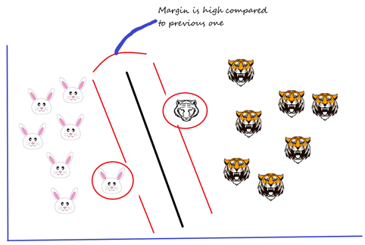
https://medium.com

Slide 9


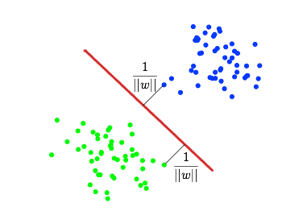
Finding the most suitable hyperplane
https://habr.com/ru/post/105220/

Slide 10
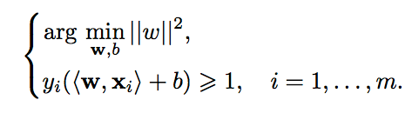

https://ru.wikipedia.org/wiki/Метод_опорных_векторов

Slide 11
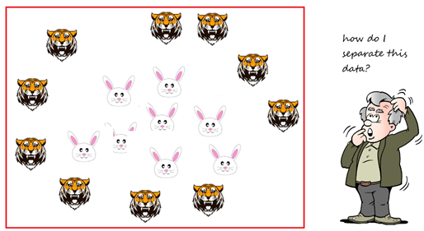
https://medium.com

Slide 12
Introduction to non-linear SVMs
https://medium.com

Slide 13
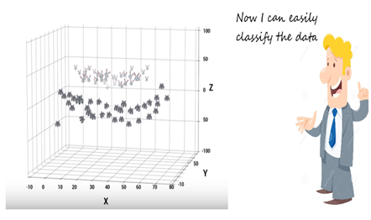
https://medium.com

Slide 14



https://habr.com/ru/post/105220/

Slide 15

Tuning parameters of SVM

Slide 16
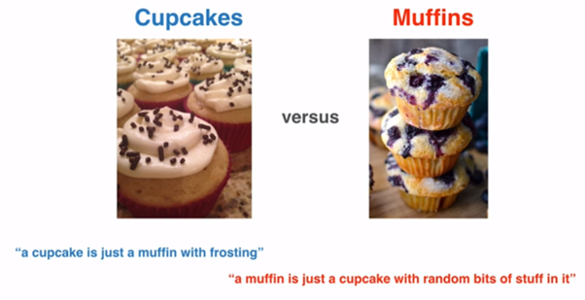
https://medium.com

Slide 17
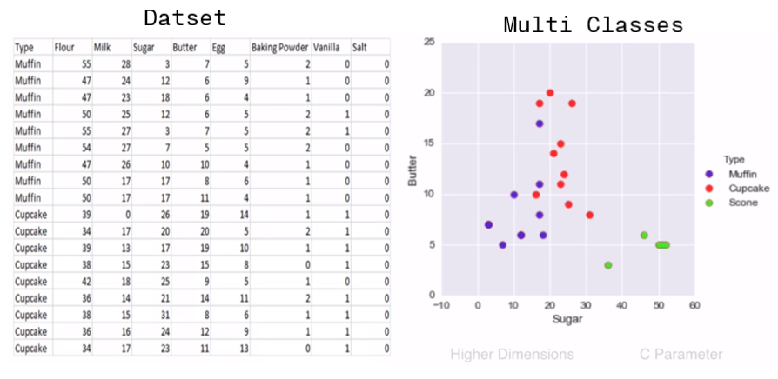
https://medium.com

Slide 18
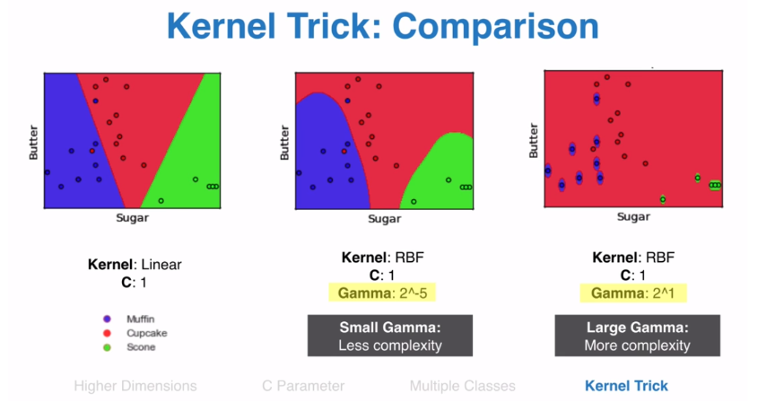
https://medium.com

Slide 19
Thank you.

